Slide 1
Model Zoo / Tutorials SIG Update
Wenbing Li (Microsoft)

Slide 2
Agenda
A model zoo for the mobile app
Quantization
The out-of-box model
Roadmap Priority
ONNX Model Hub (Mark & Jason)

Slide 3
Quantization
Quantized model (contributed by Intel):
Resnet50
VGG
ShuffleNetV2
Done by this Intel® Neural Compressor
Model | Download | Download (with sample test data) | ONNX version | Opset version | Top-1 accuracy (%) | latency (ms)
ResNet50_fp32 | 97.8 MB | 92.0 MB | 1.7.0 | 12 | 74.97 | 8.32
ResNet50_int8 | 24.6 MB | 22.3 MB | 1.7.0 | 12 | 74.77 | 4.30

Slide 4
The out-of-box model
Why
Simplify the model inference
More portable
Example
GPT-2 with Beam Search Generation, gpt2-bs
Example script of the model building in onnxruntime-extensions

Slide 5
Roadmap Priority
Welcome more models
STOA
Mobile
Dealing with legacy operations and models
Optimize the model uploading process

Slide 6

ONNX Model Hub
Mark Hamilton
Synapse Analytics at Microsoft
Jason Wang
CSX Data at Microsoft

Slide 7
Why
Simple and easy startup
Eliminate boilerplate code
Facilitate code sharing
Build flexible applications on top
Parity with other ecosystems:
import onnx
model = onnx.hub.load("AlexNet")
import torch
model = torch.hub.load('facebookresearch/dino:main', 'dino_vits16')
import tensorflow_hub as hub
model = hub.KerasLayer("https://tfhub.dev/google/nnlm-en-dim128/2")

Slide 8
Considerations
ONNX/models hosts models in git LFS
Versioning should align with git
Need to support multilingual clients
Language agnostic protocol layer
Should support private and user-hosted hubs
Any repo should be able to be a hub
Should be secure and efficient
Checksums
Local Caching
Limited maintenance required
Should to auto-gen from existing ONNX/models infra

Slide 9
ONNX Hub Architecture
onnx/onnx Repo
onnx/models Repo
Git LFS Storage
ONNX Hub Python Client
M1 v2 Pointer
M1 v2
M1 v1
M2 v3 Pointer
M2 v3
M1 v2
M1 v2
MANIFEST.json
…
MN v1 Pointer
MN v1
Local Machine
Local Process
Model Cache
import onnx
model = onnx.hub.load(‘modelN’)
MN v1

Slide 10
API Tour
from onnx import hub
# Load from onnx/models:master latest opset
model = hub.load("AlexNet")
# Load from onnx/models:master opset 3
specific_opset_model = hub.load("AlexNet", opset=3)
# Load from a fixed hash
old_model = hub.load("AlexNet", repo="onnx/models:ad5c181f1646225f0")
# Load from a user repo
old_model = hub.load("AlexNet", repo="mhamilton723/models:master")

Slide 11
API Tour
from onnx import hub
# Set custom cache locations
hub.set_dir("/foo/bar/my_new_cache")
# List all models and associated metadata
model_infos = hub.list_models()
vision_model_infos = hub.list_models(tag_list=["vision"])
# Inspect a model prior to downloading
model_size = hub.get_model_info("AlexNet").metadata["model_size"]

Slide 12
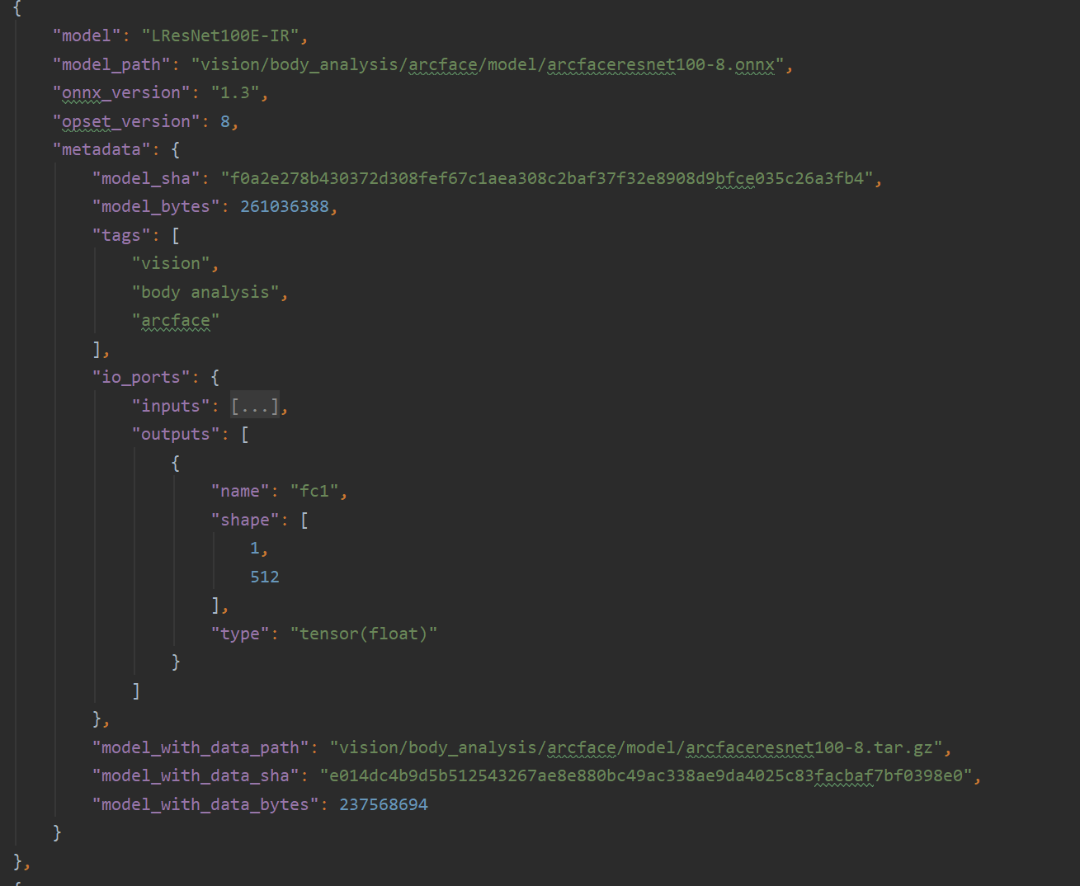
Autogenned Manifest:
Created from existing markdown tables
Contains 120 different models
Metadata for
Checksumming
Inspecting IO structure
Searching by tags
Downloading paired training data
Checking model size before download

Slide 13
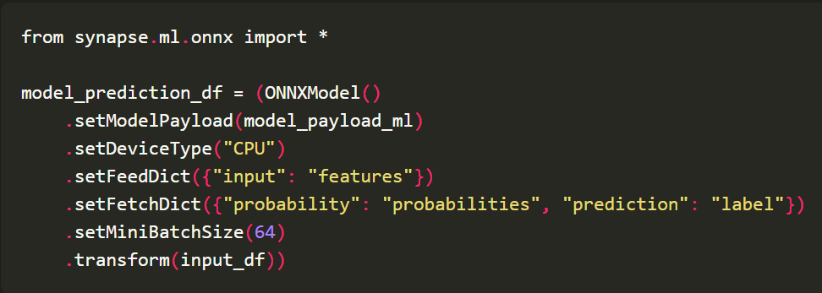
Next Steps
JVM SDK for Apache Spark based Distributed ONNX Inference
Responsible AI metadata
Include Responsible AI (fairness metrics, feature weights, etc.) related metrics in the metadata section.

Slide 14
Feedback Welcome
Try it out today:
pip install onnx-weekly
Docs:
https://aka.ms/onnx-hub
Email:
marhamil@microsoft.com, jasowang@microsoft.com
Thank you for your help building this!
Wenbing Li, Prasanth Pulavarthi, Jacky Chen, Yuan Yu, Guenther Schmuelling, Ke Zhang, ONNX working group, and others

Slide 15
